Slide 1
FINDING THE BEST SPOT TO START A RESTAURANT IN NYC
AUSHIN RAJ
JUNE,2021

Slide 2
CONTENTS
Introduction
Data
Analysis
Result

Slide 3
INTRODUCTION
NEW YORK is a big city visited by many every year presenting a great opportunity for investors.
If a restaurant is to be opened in the city , where would be the best spot to target tourists?
What is the trending food type the proposed restaurant can provide?

Slide 4
DATA
Geocoder package for latitude and longitude coordinates.
Foursquare API is the main source of data in our problem.
Two datasets were retrieved, cleaned, and prepared for analysis
Hotels dataset with locations
Trending restaurants dataset with categories and location

Slide 5
ANALYSIS AND RESULTS

Slide 6
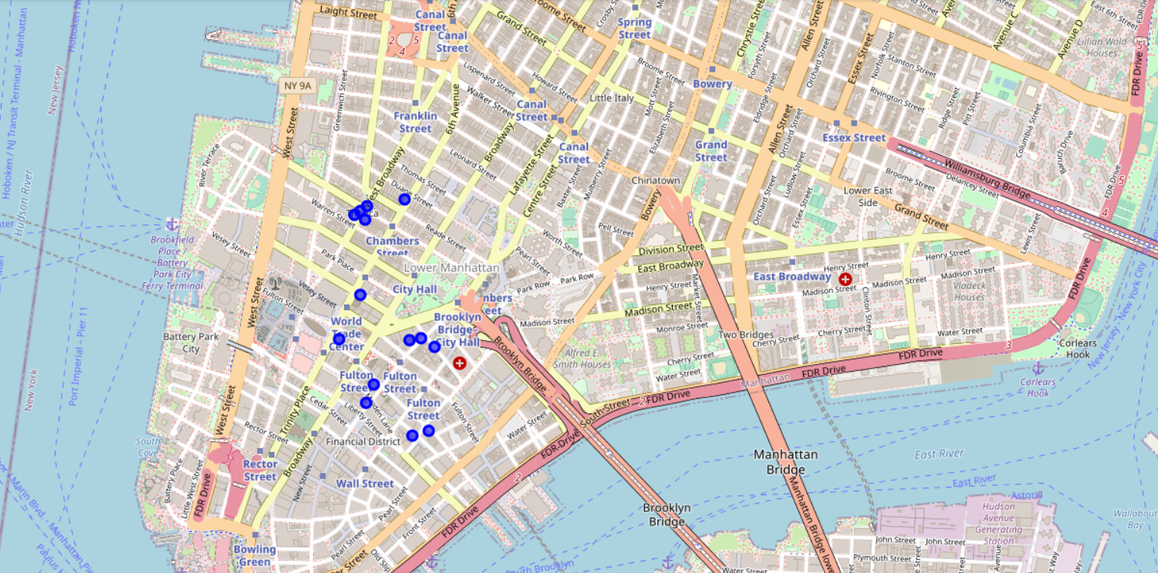
HOTEL LOCATIONS IN NYC
The hotels data was visualized on a map with folium to see where they are located.
To find the touristic areas (where there are hotels in high densities), we need to group the hotels in clusters.
By visual inspection, we can see that they can be clustered into 3 groups.

Slide 7
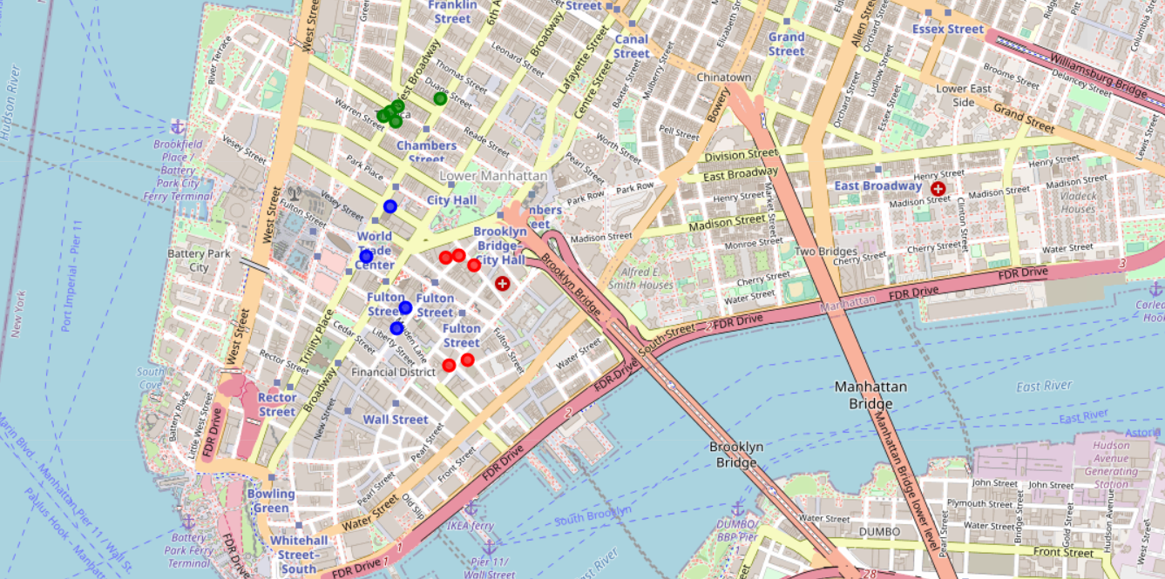
Clustering hotels with k-means
K-Means Clustering algorithm was used to group the hotels in three clusters.
Red-green-blue coloring scheme was used to differentiate hotels of different clusters.

Slide 8
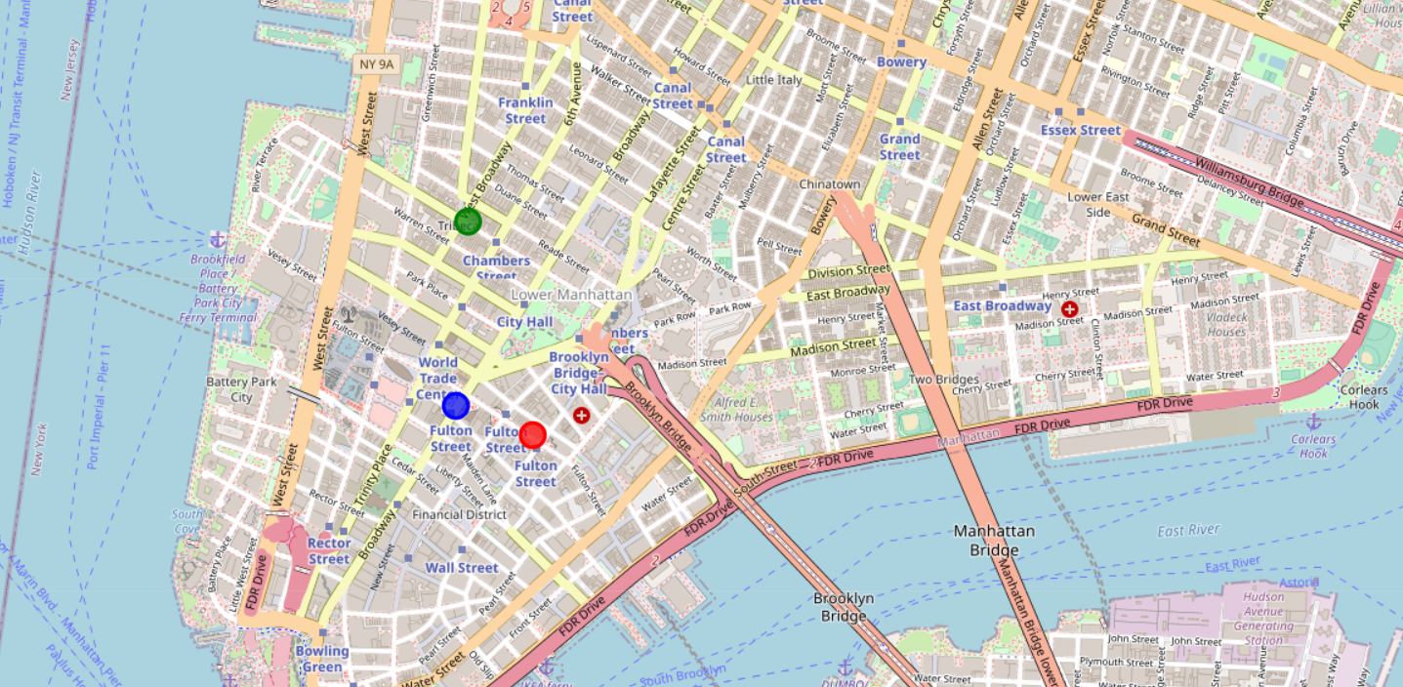
CLUSTERS CENTERS
Each cluster generated by K-Means had hotels centered around a single point, these points location coordinates were retrieved and visualized.

Slide 9
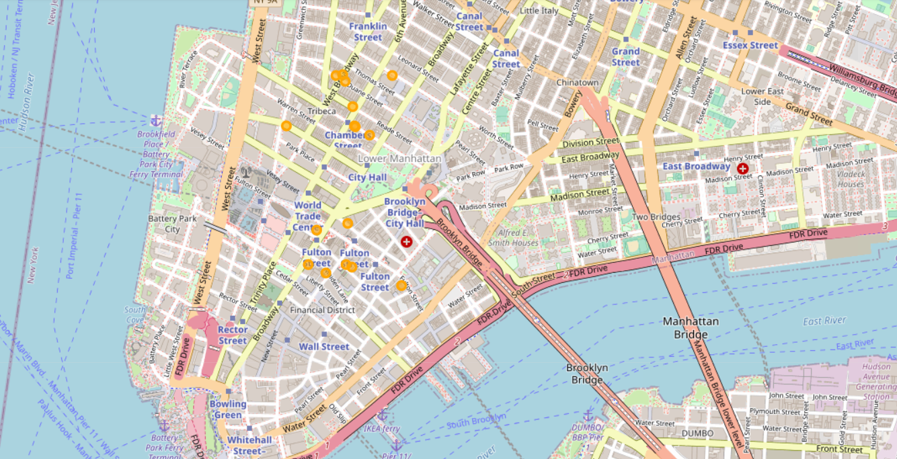
RESTAURANTS LOCATION IN NYC
Restaurants locations were retrieved from Foursquare API and visualized on the map.
To know which hotel cluster had the lowest competition in restaurants we need to classify the restaurants in these clusters and count them.

Slide 10
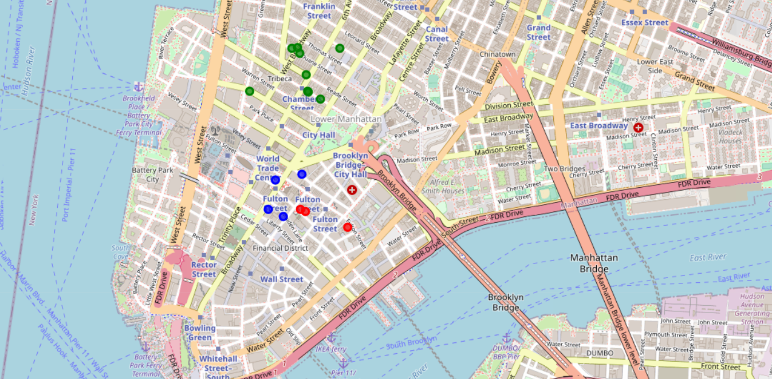
CLASSIFYING RESTAURANTS USING KNN
KNN Classification algorithm was used to assign a class label to each restaurant in our dataset.
The KNN model was trained on the centers’ locations dataset.
Each restaurant was assigned the value of the closest single center.

Slide 11
Lowest competition
To find the lowest level of competition we look for the area of the minimum number of restaurants.
It was found that the red region have minimum number of restaurants.
Class Labels | Number Of Restaurants
0(Red) | 3
1(Green) | 9
2(Blue) | 4

Slide 12
OPPORTUNITY EVALUATION
To accurately evaluate the opportunity in the red region, we calculated the ratio of number of restaurants to the number of hotels.
It was found that the red region had only 3 restaurants for 5 hotels , making it as the lowest ratio for number of restaurants to number of hotels.
With minimum competition and attractive opportunity, the red region is the suitable spot for starting a new restaurant.
Cluster Label | Number Of Hotels
0(Red) | 5
1(Green) | 5
2(Blue) | 4

Slide 13
RATIO of restaurants to hotels in a region
Region | Number of Restaurant | Number of Hotel | Ratio
0(Red) | 3 | 5 | 0.6
1(Green) | 9 | 5 | 1.8
2(Blue) | 4 | 4 | 1.0

Slide 14
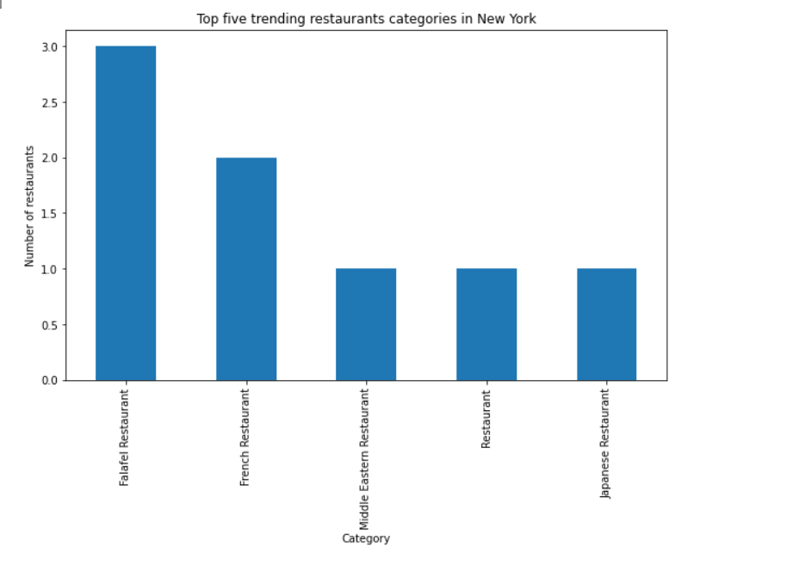
TRENDING FOOD CATEGORY
To find the food category in demand we analyzed the category of each restaurant in the dataset and counted the frequency of each category.
As the dataset represent restaurants with the highest foot-traffic levels, they were considered trending venues.
It is found that falafel is the trending food type.

Slide 15
CONCLUSION
Answer to the business question: Where in New York should investors open a restaurant, targeting tourists and what food type should they serve?
RED region (cluster 0) was found to be the best region to open a new restaurant as it was having the lowest ratio for the number of restaurants to the number of hotels.
Falafel was found to be the trending food type , Hence the best choice for the restaurant.

Slide 16
THE END

